Slide 1
Log Aggregation in K8s
Pattern, HLD and recommendations
Roger Carhuatocto
v1.0

Slide 2

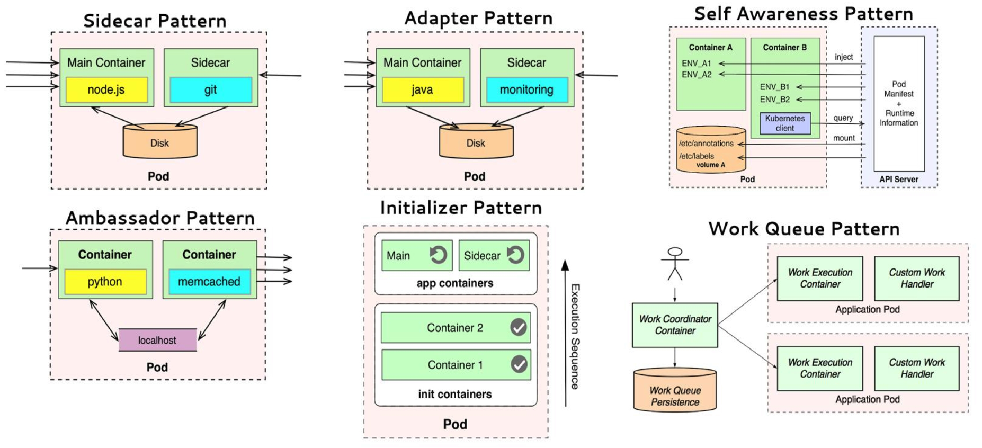
Container Patterns
3
Pod (*) is the basic “building block” in K8s.
It is the smallest unit of deployment and a running process on the cluster.
Design the Pod Chassis (Single unit of “service” might contain one or multiple App Containers).
Start with one Sidecar.
It will work as Ambassador, Adapter and Init sometimes.
It meets the Separation of Duties (Security Principle).
Bootstrap and initialize operational tasks with Init Container.
Pod
Init
Container
Sidecar Container
Application
Container
Application
Container
Application
Container
https://www.infoq.com/articles/kubernetes-effect
(*)https://kubernetes.io/docs/concepts/workloads/pods/pod-overview/

Slide 3

2. HLD
Kubernetes
Master
Worker
Edge Proxy
(Load Balancer)
Events
Pod
Pod
stdout/stderr
Pod
Infra. Log Events Storage
Sidecar
Container Pattern
DaemonSet
/var/log
Pod
Application
Container
Raw Data
Log Collector
Benefits:
The Sidecar “decouple” the operational logic (read, transform and ship the log events) from business logic.
The DaemonSet (Log Collector) collects log events through the “stdout/stderr” that Docker Engine has generated.
By using Sidecar allows fine-grained control over the logs: Segment Logs, Sanitize Logs, etc.
Kubernetes or VM
Dashboard (Correlation, Tracing, Query, …)
App. Log Events Storage & Indexer
Metrics
Raw Data
Raw Data
Events
Events
Events
VM_{x}
VM_{y}
VM_{z}
Proxy_{x}
Proxy_{y}
Proxy_{y}
Logs
Logs
Logs
App Design Pattern
App_{x}
App_{y}
App_{y}
Push
Logs
Push
Logs
Push
Logs
Data_{x}
Data_{y}
Data_{y}
(*) https://kubernetes.io/docs/concepts/cluster-administration/logging

Slide 4
3. Best Practices
Design the Pod Chassis and implements the Sidecar for Log Aggregation.
Structure your Logs, for example:
<Timestamp>.<AppID>.<ServiceID>.<CorrelationID>.<LogLevel>.<LogDetails>
CorrelationID: Single and common Transaction ID across the entire end-to-end call for each client.
AppID & ServiceID: ensures that services and applications are being logged.
LogLevel & LogDetails: standardizes the logging levels within the entire stack.
Ensure that sensitive data (secrets) is not being logged or not be in clear (Log Sanitization & Log Transformation).
Archive, Split

